Slide 1
C++
Md. Abdur Rahman
Senior Computer Scientist
Centre for Advanced in Research in Sciences (CARS)
University of Dhaka

Slide 2
Overview
C++ is a middle-level programming language developed by Bjarne Stroustrup starting in 1979 at Bell Labs.
C++ runs on a variety of platforms, such as Windows, Mac OS, and the various versions of UNIX.
statically typed, compiled, general-purpose case-sensitive, free-form programming language that supports procedural, object-oriented, and generic programming

Slide 3
Overview
Static typing: type checking is performed during compile-time as opposed to run-time.
C++ is a middle-level language, as it comprises a combination of both high-level and low-level language features.
C++ is a superset of C, and that virtually any legal C program is a legal C++ program

Slide 4
Use of C++
C++ is used by hundreds of thousands of programmers in essentially every application domain.
C++ is used to write device drivers and other for hardware manipulation software under realtime constraints.
C++ is widely used for teaching and research because it is clean enough for successful teaching of basic concepts.

Slide 5
Use of C++
Anyone who has used either an Apple Macintosh or a PC running Windows has indirectly used C++ because the primary user interfaces of these systems are written in C++.

Slide 6
Installation
Download install .net framework
Download
codeblocks-17.12mingw-setup
includes additionally the GCC/G++ compiler
https://sourceforge.net/projects/codeblocks/files/Binaries/17.12/Windows/codeblocks-17.12-setup.exe/download
Install

Slide 7
Installation
Verify the Compiler's
Goto "Settings" menu ⇒ "Compiler..." ⇒ In "Selected Compiler", choose "GNU GCC Compiler" ⇒ Select tab "Toolchain Executables" ⇒ Check the "Compiler's Installation Directory“
It shall be set to the "MinGW" sub-directory
eg: C:\Program Files (x86)\CodeBlocks\MinGW

Slide 8
Installation
Check the debugger's path
Goto "Settings" menu ⇒ "Debugger..." ⇒ Expand "GDB/CDB debugger" ⇒ Select "Default" ⇒ In "Executable path", provide the full-path name of "gdb.exe", for example, "c:\Program Files\codeblocks\MinGW\bin\gdb.exe".

Slide 9
Writing Programs
File ⇒ New ⇒ Empty File.
Type your code
Build (Compile and Link): Select "Build" menu ⇒ Build (Ctrl-F9).
Run: Select "Build" menu ⇒ Run (Ctrl-F10).
#include <iostream>
int main()
{
std::cout << "Hello World!" << std::endl;
}

Slide 10
Writing Programs (under Project)
File ⇒ New ⇒ Project... ⇒ Console Application ⇒ Go.
The "Console Application" wizard appears:
Next
Select "C++" ⇒ Next.
In "Project Title", enter "HelloProject". In "Folder to create project in", set to your working directory, e.g., "d:\project". Accept the default for the rest ⇒ Next.
In "Compiler" field, accept the defaults of "GNU GCC Compiler" ⇒ Finish.

Slide 11
Writing Programs (under Project)
Under the "Management" pane ⇒ Choose "Projects" tab ⇒ Expand the project node "HelloProject" ⇒ Expand "Source" node ⇒ Double-click "main.cpp", which is a template program to say "Hello, world!".
To build the program, select "Build" menu ⇒ Build.
To run the program, select "Build" menu ⇒ Run.
Debug: www.youtube.com/watch?v=Jab1qj_QR8s

Slide 12
Writing Programs (under Project)
To create more source file or header file under the project:
File ⇒ New File... ⇒ Select C/C++ source or C/C++ header.
C++ ⇒ Next.
In "Filename with full path" ⇒ Click the "Navigate" (...) button to navigate to the project directory and enter the new file name. Check both the "Debug" and "Release" boxes (or "All") ⇒ Finish.

Slide 13
Structure of a program
// my first program in C++ [for commenting]
#include <iostream> [preprocessor directive]
using namespace std;
int main ()
{
cout << "Hello World!";
return 0;
}

Slide 14
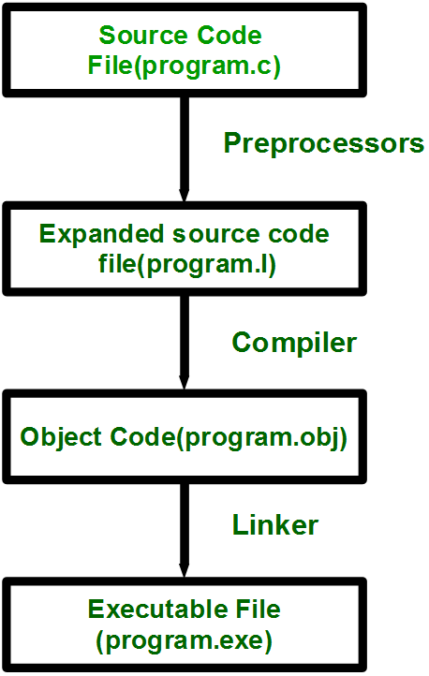
Steps between writing and executing a program
Source code is stored in the file program.c.
This file is then processed by preprocessors and an expanded source code file is generated named program.
This expanded file is compiled by the compiler and an object code file is generated named program.obj.
Finally the linker links this object code file to the object code of the library functions to generate the executable file program.exe .

Slide 15
#include <iostream>
Lines beginning with a hash sign (#) are directives for the preprocessor.
Indications for the compiler's preprocessor.
The directive #include <iostream> tells the preprocessor to include the iostream standard file.
This specific file (iostream) includes the declarations of the basic standard input-output library in C++, and it is included because its functionality is going to be used later in the program.

Slide 16
C/C++ Preprocessors
Preprocessors are programs that processes our source code before compilation.
All of these preprocessor directive begins with a ‘#’ (hash) symbol.
Examples of some preprocessor directives are: #include , #define, #ifndef etc.

Slide 17
Hello World Analysis
int main() { ... }
defines a new function named main. The main function is called upon execution of the program, it must always return a number of the int type.
Here, the int is what is called the function's return type. The value returned by the main function is an exit code.
By convention, a program exit code of 0 or EXIT_SUCCESS is interpreted as success by a system that executes the program. Any other return code is associated with an error.

Slide 18
Hello World Analysis
int main() { ... }
If no return statement is present, the main function (and thus, the program itself) returns 0 by default. In this example, we don't need to explicitly write return 0;.
All other functions, except those that return the void type, must explicitly return a value according to their return type, or else must not return at all.

Slide 19
Hello World Analysis
std::cout << "Hello World!" << std::endl;
prints "Hello World!" to the standard output stream
std is a namespace
:: scope resolution operator look-ups for objects
std::cout is the standard output stream object
Here << is the stream insertion operator
allows stream insertions to be chained,
eg: std::cout << "Foo" << " Bar";
prints "FooBar" to the console.

Slide 20
Hello World Analysis
std::endl is a special I/O stream manipulator object
std::endl does two things:
inserts the end-of-line character
flushes the stream buffer to force the text to show up on the console
An alternate method that avoids the flush is:
std::cout << "Hello World!\n";
; notifies the compiler that a statement has ended
// single-line comment
/*
* This is a block comment.
*/

Slide 21
Whitespace in C++
int age;
Here must be at least one whitespace character between int and age for the compiler to be able to distinguish them.
fruit = apples + oranges; // Get the total fruit
Here, no whitespace characters are necessary between fruit and =, or between = and apples

Slide 22
Data Types
All variables use data-type during declaration to restrict the type of data to be stored
Data types are used to tell the variables the type of data it can store.
Data types in C++ is mainly divided into two types:
Primitive Built-in Types
Abstract or user defined data type

Slide 23
Data Types
Primitive data types
These data types are built-in or predefined data types and can be used directly by the user to declare variables
Type | Keyword
Boolean | bool
Character | char
Integer | int
Floating point | float
Double floating point | Double
Valueless | Void
Wide character | wchar_t

Slide 24
Primitive data types
Boolean: used for storing boolean or logical values. A boolean variable can store either true or false.
Character: used for storing characters and typically requires one byte of memory space.
Integer: used for integer data types is int. Integers typically requires 4 bytes.
Floating Point: stores single precision floating point values or decimal values.
Double Floating Point: stores double precision floating point values or decimal values.
void: Void means without any value. void datatype represents a valueless entity. Void data type is used for those function which does not returns a value.
Wide Character: is also a character data type but this data type has size greater than the normal 8-bit datatype.

Slide 25
Data Type
Data type Modifiers
used with the built-in data types to modify the length of data that a particular data type can hold.
Signed
Unsigned
Short
Long

Slide 26
Name | Description | Size* | Range*
char | Character or small integer. | 1byte | signed: -128 to 127 unsigned: 0 to 255
short int(short) | Short Integer. | 2bytes | signed: -32768 to 32767 unsigned: 0 to 65535
int | Integer. | 4bytes | signed: -2147483648 to 2147483647 unsigned: 0 to 4294967295
long int (long) | Long integer. | 4bytes | signed: -2147483648 to 2147483647 unsigned: 0 to 4294967295
bool | Boolean value. It can take one of two values: true or false. | 1byte | true or false
float | Floating point number. | 4bytes | +/- 3.4e +/- 38 (~7 digits)
double | Double precision floating point number. | 8bytes | +/- 1.7e +/- 308 (~15 digits)
long double | Long double precision floating point number. | 8bytes | +/- 1.7e +/- 308 (~15 digits)
wchar_t | Wide character. | 2 or 4 bytes | 1 wide character
* The values of the columns Size and Range depend on the system the program is compiled for.

Slide 27
Range Calculation
Using two's complement
signed number with N bits
min = -1 * 2^{N - 1}
max = 2^{N - 1} - 1
unsigned number with N bits are
min = 0
max = 2^{N} - 1

Slide 28
Range Calculation
Example: 8-bit char
The char has N = 8 bits.
signed char
min = -1 * 2^{N - 1} = -1 * 2⁷ = -128
max = 2^{N - 1} - 1 = 2⁷ - 1 = 127
unsigned char
min = 0
max = 2^{N} - 1 = 2⁸ - 1 = 255

